Slide 1

BLOCKCHAIN
TECHNOLOGY
PRESENTED BY
LAKSHMI H R
23MCA27
DEPT. OF MCA
SSIT TUMKUR

Slide 2

CONTENT
INTRODUCTION OF BLOCKCHAIN
HOW BLOCKCHAIN WORKS
BENEFITS OF BLOCKCHAIN
BLOCKCHAIN APPLICATIONS
CHALLENGES AND LIMITATION
FUTURE OF BLOCKCHAIN
SUMMARY
REFERENCE

Slide 3
INTRODUCTION OF BLOCKCHAIN
Blockchain is a decentralized , distributed ledger technology that enables secure and transparent recording of transactions across a network of computers .
It consists of blocks of data linked together in a chain.
Each block contains a cryptographic hash of the previous block ,creating a secure and tamper-proof record.
Blockchains are typically managed by a peer-to-peer network for use as a publicly distributed ledger.
As block each contain information about the previous block.

Slide 4
BLOCKCHAIN WORKING
TYPES OF BLOCKCHAIN
Public Blockchain : Anyone can participate and view the blockchain.
Private Blockchain : Permissioned access, controlled by a single organization.
Consortium Blockchain : Shared control among a group of organizations.
Hybrid Blockchain : It combines elements of both public and private blockchain.

Slide 5

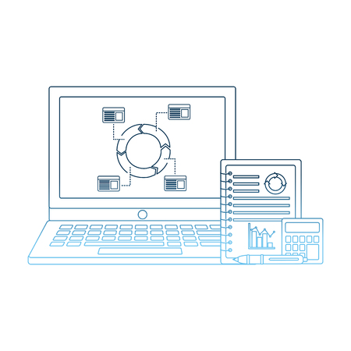



BLOCKCHAIN WORKING
Requesting a transaction
Validation
Verification
Transaction is completed
The block joins the chain
A block is created

Slide 6
BENEFITS OF BLOCKCHAIN
Increased security and trust through decentralization and cryptographic techniques.
Enhanced transparency and accountability, leading to reduced fraud and error.
Streamlined processes, lower costs and greater efficiency by removing intermediaries.
Blockchain enables the tracking of assets and transactions throughout their lifecycle from creation to final destination.
Streamlined process is by automating and digitizing manual processes.
It is cost reduction , blockchain eliminates the need for intermediaries such as bank or clearinghouses in many transaction reducing associated fees and costs.

Slide 7
BLOCKCHAIN APPLICATION
BANKING
1
2
VOTING SYSTEM
BLOCKCHAIN
HEALTHCARE
3
4
SUPPLY CHAIN

Slide 8
CHALLENGES AND LIMITATION
Scalability : processing large volumes of the transactions.
Energy consumption : High electricity usage in proof of work systems.
Regulation and Compliance :Compliance and legal framework.
Interoperability : Ensuring different blockchains can communicate with each other.
Privacy and Confidentiality : Balancing the transparency of blockchain with the need to protect sensitive data and user privacy.

Slide 9
FUTURE OF BLOCKCHAIN
Continued Innovation
Regulatory Clarity
Eco-Friendly
4
6
2
1
3
5
Tokenization of Assets
Decentralized Finance
Integration with Emerging

Slide 10
SUMMARY
Blockchain technology has the potential to revolution various industries by enhancing security, transparency and efficiency.
Understanding its principles and applications is essential for businesses and individuals navigating the digital economy.
Immutable Ledger transactions on the blockchain are grouped into blocks and linked together in a chronological chain.
Once data is recorded on the block chain it can not be altered or deleted ensuring data integrity and trust.

Slide 11
REFERENCE
https://www.ibm.com.
https://www.blockchain.com.
https://www.simpllilearn.com.
https://www.investopedia.com.

Slide 12
THANK YOU

